Slide 1
Marketing Update: Secure 3 Conversions Secure Inventory
February 2021

Slide 2
Secure 3 Conversions
Developing a plan to convert the remaining 30 Secure 3 accounts to Secure 5 over an 18 month time horizon
Goal is to significantly reduce the amount of time and effort required to do the upgrade
Working with Legal, Finance and Customer Success to streamline the renewal contracting process
Grouping the projects to ensure we focus our resources where they can the most impact:
Complex technical solutions for important accounts
Strategic cross sell opportunities
Grocery
Low value

Slide 3
Secure Inventory Overview
Secure Inventory is part of the Appriss Retail Secure Exception Based Reporting (EBR) family of products, leveraging all of the platform capabilities to identify Inventory risks associated with Shrink (Unexplained Loss), Availability (out of stock or excess stock) , and Accuracy (unit level on hand)
Secure relies on prescriptive set of Inventory data sources which are required to identify issues related to shrink, stock availability, and inventory accuracy within the store

Slide 4
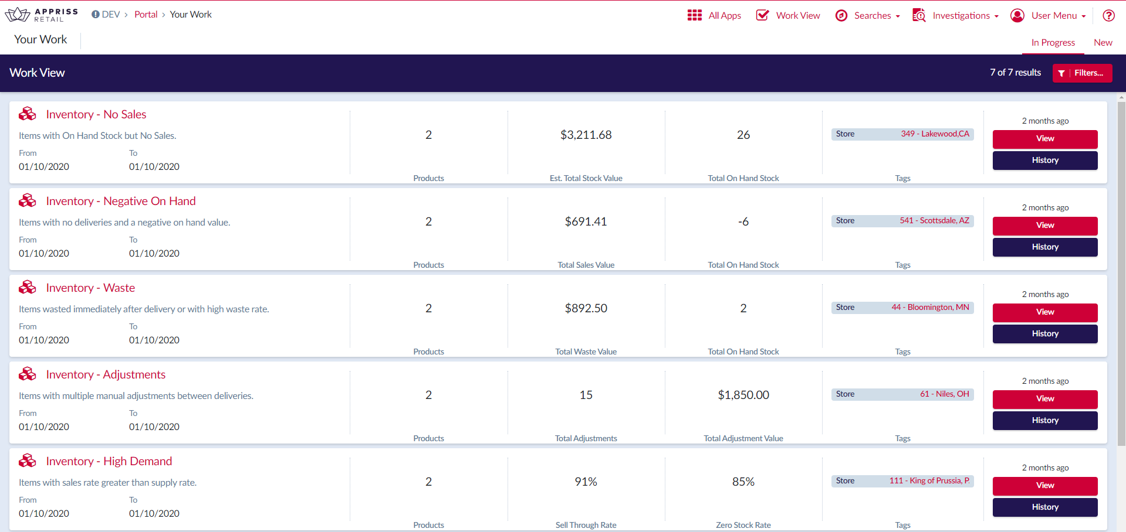
DSD Work Item List

Slide 5
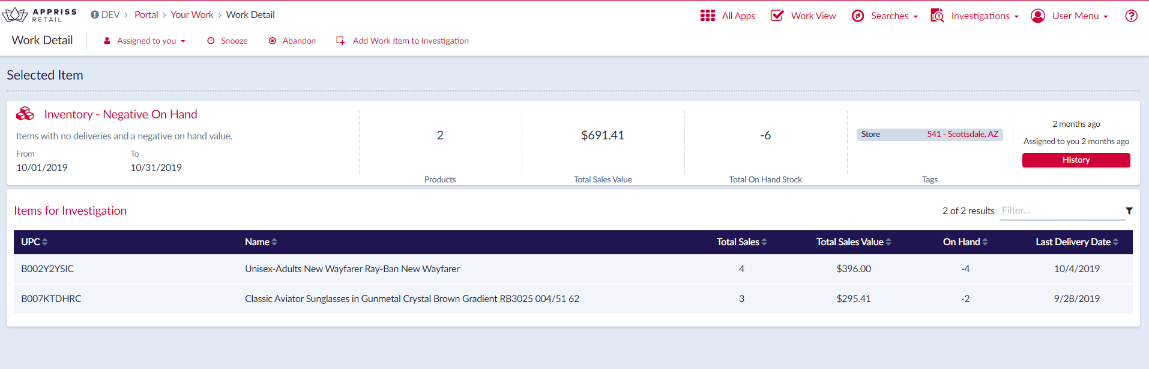
DSD Work Item Detail

Slide 6
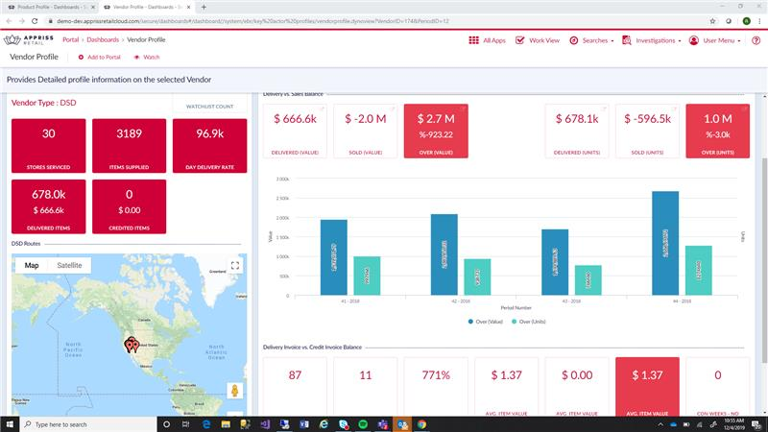
DSD Vendor Profile

Slide 7
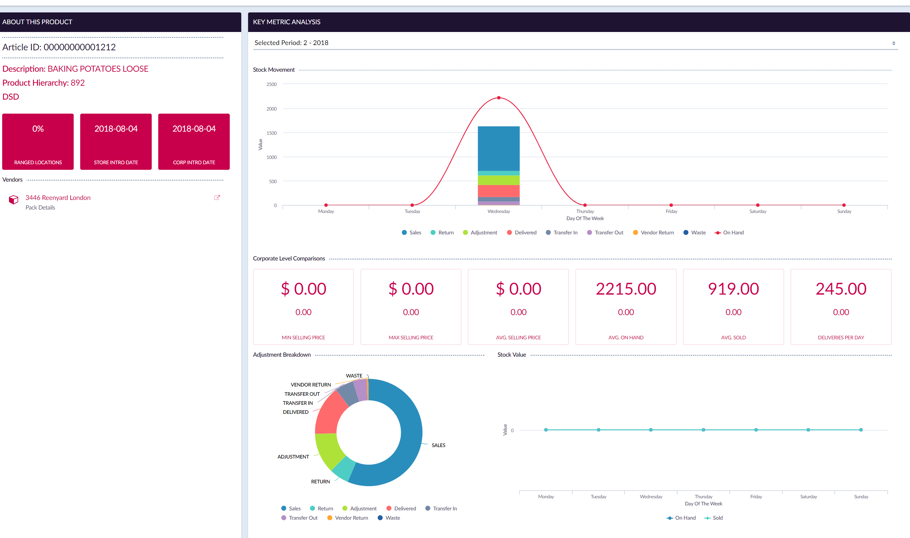
DSD Product Profile

Slide 8
Inventory Exceptions
# | Inventory Exception | Description
1 | Item on hand in store with no outbound movement over a given period of time | Finds examples of items which have stock on hand but no movement in the on hand stock. This analysis would performed over a period.
2 | Negative on hand of a warehouse stocked item - Item sold but never received | Finds examples of items which have a negative stock on hand position, positive corresponding sales but zero deliveries. This analysis would performed over a period.
3 | Manual Adjustments | Finds examples where manual adjustments occur to the ledger to correct issues which may have preceded the event or may cause other atomic operations to occur
4 | General Build of Stock | Via stock levels Find examples of items which have systemic issues identified by line items where the amount received is greater than the average indicating Case pack setup issues, data entry errors, receiving under generic items.
5 | DSD - Vendor Over Delivered / Under Delivered Analysis | Finds examples of where the Vendor is over supplying the store with a certain product type or not supplying enough product to meet sales demand. The analysis examines how the minimum and maximum product type varies by Vendor
6 | DSD – Credit and Invoice issues | Finds examples of when a Vendor has not issued a credit in a given location for prolonged amount of time or missing deliveries or duplicate invoices
7 | DSD - Low credit Ratio | Finds examples of where the credit ratio as % of sales and deliveries is lower than other vendors and location associated with hierarchical designation.
8 | DSD - Item on hand but no sales | Finds examples of where DSD delivered items are showing an on hand level but no corresponding sales.
9 | No Stock On Hand for extended period of time | Indicates an assortment issue, and a potential for items to be sold without correctly be authorized for the location

Slide 9
Secure Inventory Projects
Delivered two inventory projects in 2020 (Kroger DSD and SEG Pilot)
Projects generally are similar to Secure Store taking about 16 weeks to deploy
Require more upfront consulting and technical analysis to identify data sources and scope the effort for the client.

